Slide 1

Optimizing Employee Retention and Performance Through Data-Driven HR Strategies
-Presented By
Misba Hudewale
Madhurjya Deka
Pralay Kalaskar

Slide 2
Introduction
• Retaining top talent and enhancing employee performance are essential for organizational success.
• High turnover and suboptimal performance impact productivity and profitability.
• The HR department aims to leverage data-driven insights to address these challenges.

Slide 3
Problem Statement
The HR department faces significant challenges related to high employee turnover and subpar performance levels, which negatively impact overall productivity and profitability. The department seeks to leverage existing HR data to identify key factors contributing to these issues. The objective is to analyze the data to develop proactive strategies aimed at improving employee retention and performance.

Slide 4
Project Objectives
Data Analysis: Conduct a thorough analysis of historical HR data, including employee demographics, job roles, compensation, performance evaluations, and turnover records.
Pattern Recognition: Identify patterns, trends, and correlations within the HR data to understand the underlying factors influencing employee turnover and performance.
Strategy Development: Formulate a data-driven strategy to enhance employee retention and performance, incorporating targeted training programs, compensation adjustments, and career progression plans.

Slide 5
Methodology
1. Data Collection & Pre-Processing:
- Gather HR data from internal systems, including demographic details, job roles, compensation records, performance evaluations, and turnover history.
-Pre-process collected data to address missing values, outliers, and inconsistencies.
2. Data Analysis:
Descriptive Statistics & Correlation Analysis:Summarize data to identify general trends and nalyze relationships between different variables.
Predictive Modeling & Pattern Recognition: Develop machine learning models to predict employee turnover and performance based on historical data.Identify specific trends and correlations that could indicate underlying issues or opportunities within the workforce.
3.Strategy Formulation:
Use insights gained from analysis to create strategies aimed at improving employee retention and performance and formulate targeted interventions, such as customized training programs, compensation adjustments,etc.

Slide 6
Tools Used
Python (Jupyter Lab)
Libraries used:
Pandas for data manipulation.
Matplotlib and Seaborn for visualizations.
NumPy for numerical computing.
sklearn.model_selection: For splitting data and performing cross-validation.
sklearn.ensemble: For building ensemble models like Random Forest.
sklearn.metrics: For evaluating model performance using various metrics

Slide 7
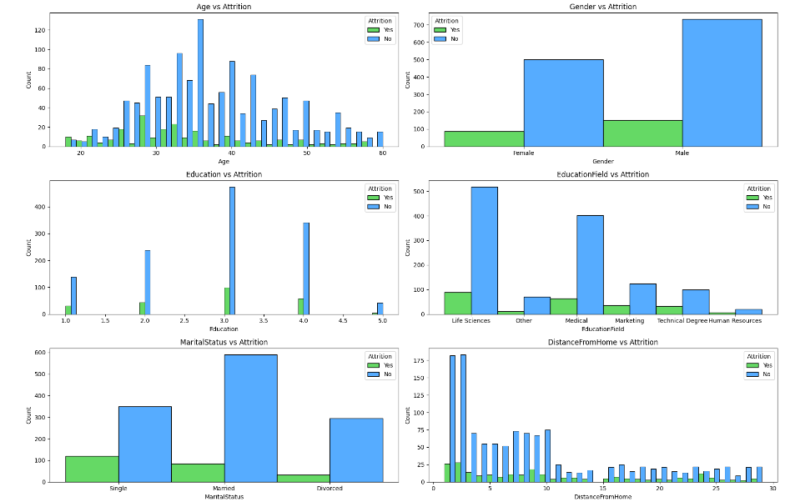
Analysis
Demographic Factors:
Younger employees, particularly those below 30, show higher attrition rates compared to older age groups.
Employees with lower education levels (e.g., high school) tend to have higher attrition rates compared to those with higher education (e.g., bachelor's degree or above).
Attrition rates are slightly higher among male employees compared to female employees, though the difference is not substantial.

Slide 8
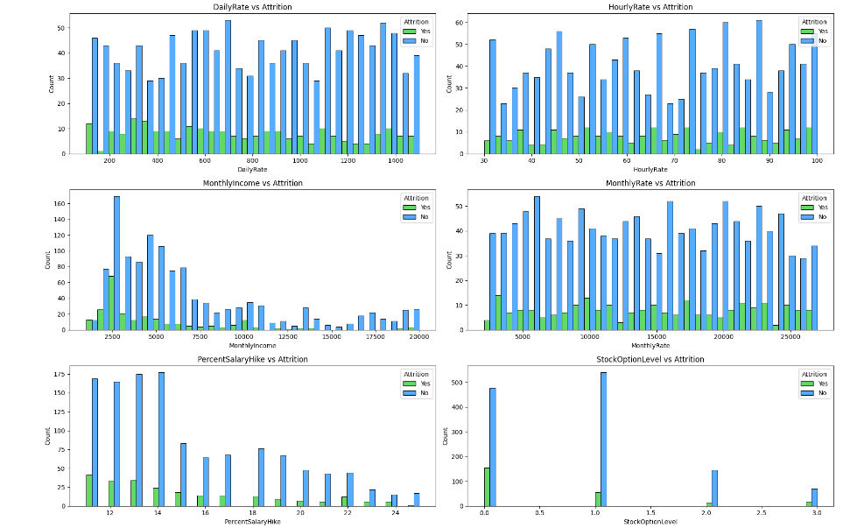
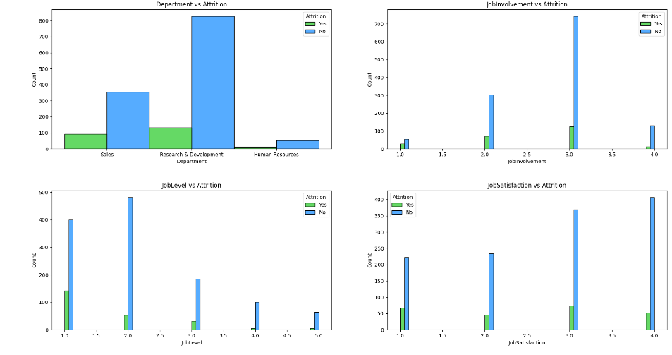
Compensation & Work-Related Factors:
Higher attrition is observed among employees earning below $5000, whereas those earning above $10,000 tend to stay longer.
Employees without stock options show the highest attrition, with attrition decreasing as stock option levels increase.
Attrition is surprisingly higher among employees who received an 11-13% salary hike, compared to those with lower or higher hikes.
Better work-life balance is correlated with lower attrition rates, with most employees rating their balance as moderate (3 out of 4).
A strong link exists between working overtime and higher attrition, making this a critical factor to address.
Lower job satisfaction correlates with higher attrition, highlighting the importance of improving employee satisfaction.

Slide 9
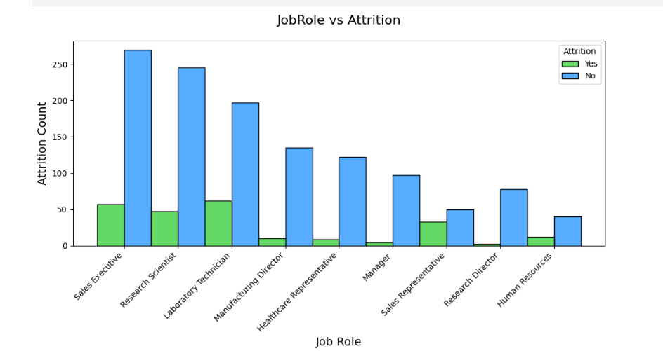
Job Roles:
Sales Executives have one of the highest attrition rates, indicating potential challenges in this role that may need to be addressed.
Research Scientists also exhibit a high rate of attrition, suggesting issues related to job satisfaction or other factors in this role.
The Human Resources role shows one of the lowest attrition rates, indicating stability and potentially high job satisfaction in this area.

Slide 10
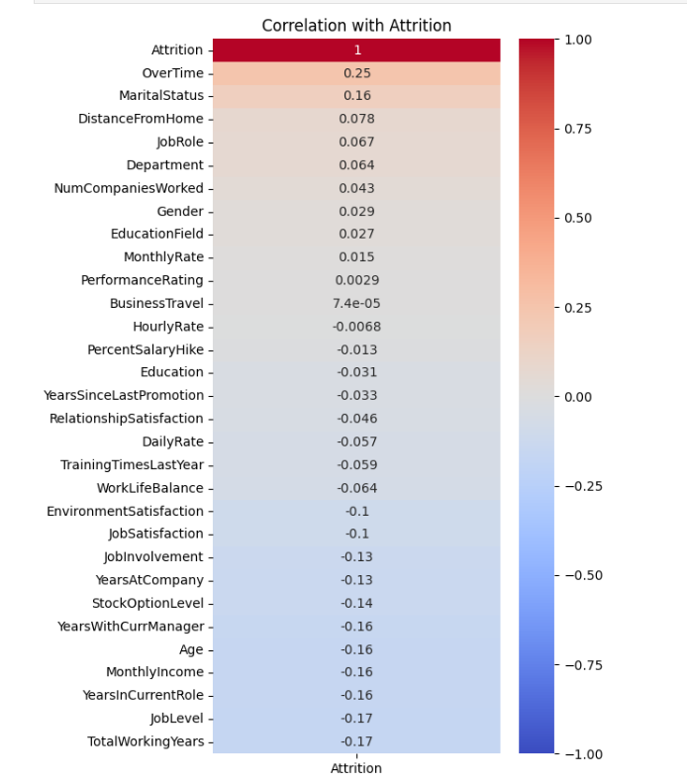
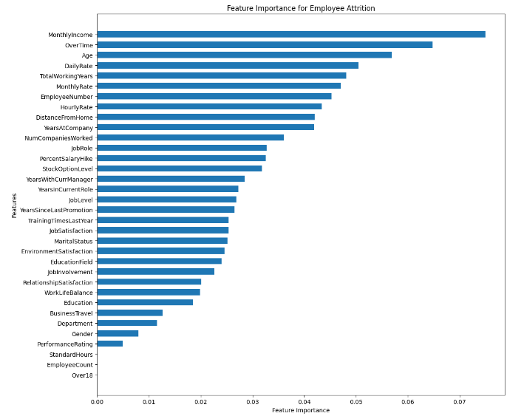
Correlation By Attrition & Feature Importance:
Overtime has the strongest positive correlation with attrition (0.25).
TotalWorkingYears, JobLevel, and MonthlyIncome have the strongest negative correlations with attrition (-0.17 to -0.16).
Monthly Income is the most important factor in predicting attrition.
Overtime is the second most important feature.
Age and Daily Rate are also significant factors in predicting attrition.

Slide 11
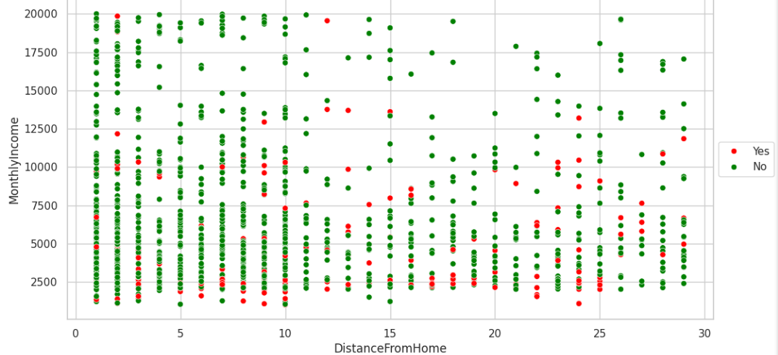
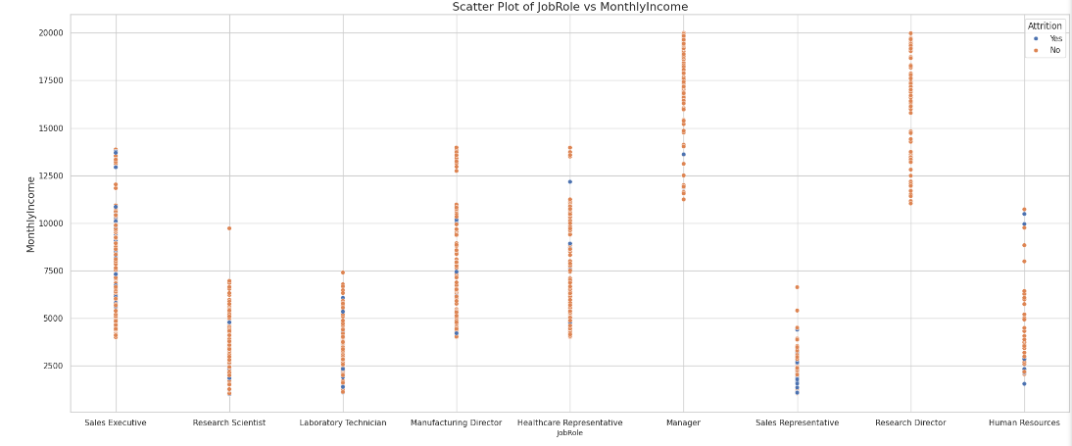
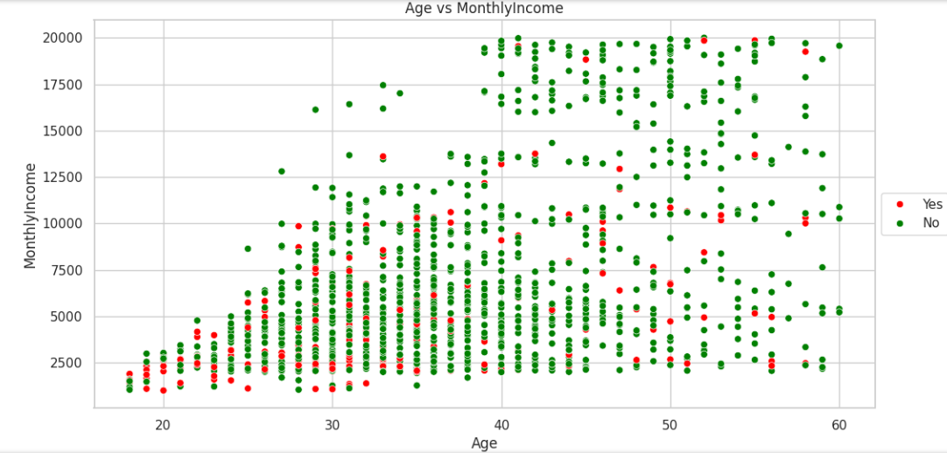
Scatter Plots :
Highest incomes observed in the 35-55 age range.
Attrition more prevalent among younger employees and those with lower incomes.
Distinct income clusters are visible at specific levels (e.g., 5,000, 10,000, 15,000), possibly indicating salary bands.
High concentration of both red and green dots at shorter distances from home, suggesting proximity to work is common across income levels.
Managers and Research Directors tend to have higher incomes.
Lower-paying roles like Laboratory Technicians show more attrition.

Slide 12
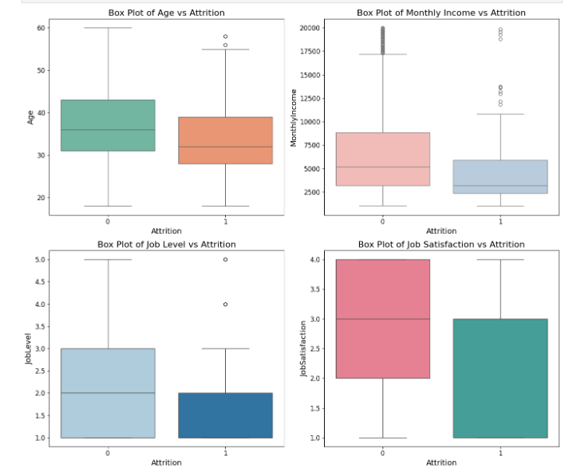
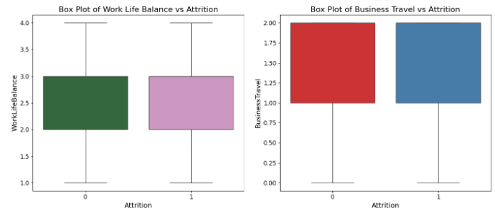
Box Plots:
- Employees who left the company tend to be younger.
- Median age of those who left is lower than those who stayed.
- Employees with higher monthly incomes are less likely to leave.
- Median income of employees who stayed is higher than those who left.
- More high-income outliers among those who stayed.
- Lower job levels appear to have higher attrition rates.
- Median job level for those who left is lower compared to those who stayed.
- Suggests employees in lower job levels may be more likely to leave.
- Employees who stayed have a higher median job satisfaction score.
- Indicates higher job satisfaction is associated with lower attrition.

Slide 13
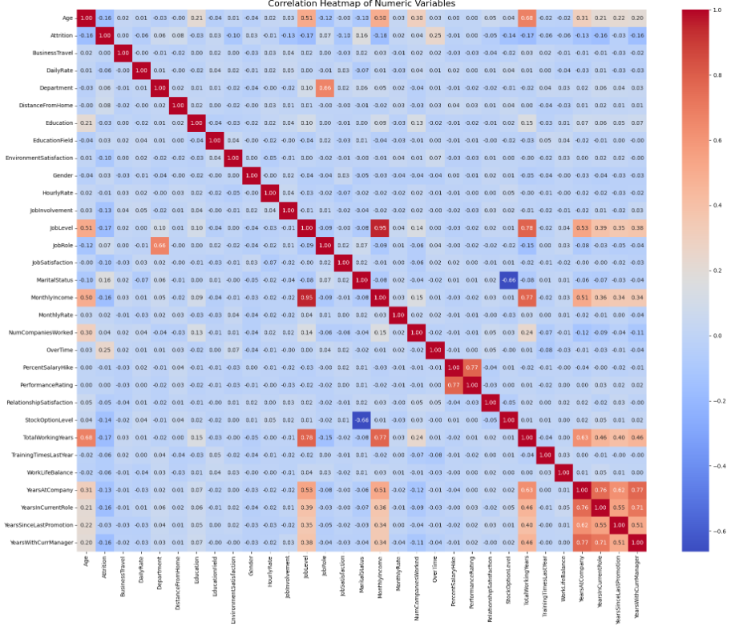
Correlation Between Numeric Variables:
1. Strong positive correlations:
- WorkLifeBalanceLastPromotion and WorkSatisfactionLastPromotion (0.85).
- Job Satisfaction and JobInvolvement (0.81).
- PerformanceRating and YearsSinceLastPromotion (0.77).
2. Strong negative correlations:
- DistanceFromHome and Job Satisfaction (-0.54).
- YearsInCurrentRole and Job Satisfaction (-0.52).
3. Moderate positive correlations:
- Education with EnvironmentSatisfaction (0.54).
- MonthlyIncome with Age (0.50) and JobLevel (0.51).
4. Job Satisfaction, EnvironmentSatisfaction, and RelationshipSatisfaction show moderate positive correlations with each other.

Slide 14
Model & Training:
Model Used: Random Forest Classifier.
Workflow: Train-Test Split, Cross-Validation, Model Training, and Evaluation.
Metrics: Accuracy, Precision, Recall, F1 Score, ROC AUC.
1. Model Performance:
-The model shows good accuracy (around 85-86%) in classifying cases.
-There's a significant imbalance between precision (77-83%) and recall (13-18%), indicating the model is better at avoiding false positives than identifying all true positives.
2. Class Imbalance:
- The large gap between precision and recall suggests a significant class imbalance, with attrition being the minority class.
- This imbalance results in the model being cautious in predicting attrition, leading to few false positives but many false negatives.
3. Potential for Improvement:
- The model shows good discrimination ability (ROC AUC scores around 0.73-0.81), suggesting it can distinguish between classes despite the recall issue.

Slide 15
Implementing Performance Enhancement Strategies:
1. Training and Development Programs:
- Focused on employees with low job satisfaction or low job involvement.
- 647 employees targeted for these programs.
- Considers past training frequency for each employee.
2. Compensation Review:
- Targets employees with below-average income and low job satisfaction.
- 374 employees identified for potential compensation adjustments.
- Monthly incomes for these employees range from about $2,400 to $5,400.
3. Model Accuracy and KPI Monitoring:
- Model accuracy after implementing strategies is 0.88.
- KPIs monitored across different job levels.
- Includes attrition rates, average monthly income, and job satisfaction for each level.
4. Job Level Insights:
- Job level 5 has the highest monthly income and lowest attrition rate.
- Suggests a correlation between higher job levels, better compensation, and improved retention.

Slide 16
Observations
Age vs Attrition: Younger employees (20-30 years) exhibit higher attrition rates compared to older employees (40+ years).
Gender vs Attrition: Attrition rates are similar for both male and female employees despite the higher number of males.
Education and Fields: Life Sciences and Medical fields have the highest employee counts; Technical Degrees and HR fields show higher attrition rates.
Compensation and Attrition: Employees earning less than $5000 and those without stock options are more likely to leave.
Work-Related Factors: High overtime and poor work-life balance are strongly associated with higher attrition. Higher job satisfaction and senior job levels correlate with lower attrition.
Job Roles: Sales Executives and Research Scientists experience the highest attrition, while Directors and higher-level roles have lower attrition rates.
Correlation & Feature Importance: Overtime and Monthly Income are the strongest predictors of attrition. Other important factors include marital status, commute length, and job level.
Marital Status Influence: Single employees are more likely to leave compared to married employees, suggesting that family responsibilities or stability influence retention.

Slide 17
Conclusions
Financial Incentives: Equity-based incentives such as stock options are crucial for reducing attrition rates.
Commute Impact: Employees with longer commutes are more likely to leave, highlighting the need for flexible work options.
Job Satisfaction: Low job satisfaction is directly related to higher attrition rates, making it a key area for improvement.
Role-Specific Attrition: Certain job roles, particularly Sales Executives and Research Scientists, face higher attrition rates, indicating the need for targeted retention strategies.
Importance of Engagement: Improving job involvement and overall work experience is essential for retaining employees.

Slide 18
Recommendations
Enhance Compensation Packages: Increase salaries and offer stock options to improve retention, especially for lower-income employees.
Improve Work-Life Balance: Address issues related to overtime and work-life balance to reduce attrition.
Implement Remote Work Options: Explore flexible work arrangements or location-based incentives to accommodate employees with long commutes.
Focus on Job Satisfaction: Develop strategies to enhance job satisfaction across the organization, particularly in high-turnover roles.
Targeted Retention Strategies: Design specific retention initiatives for roles and fields with high attrition rates to address their unique challenges and needs.

Slide 19
THANK YOU

